Slide 1
COVID-19 Recovery Plan 2021
June 10, 2024

Slide 2
Background:
The American Rescue Plan Act of 2021 provides additional relief to address the continued impact of COVID-19. The purpose of this presentation will be to share how the needs of students, families, teachers and infrastructure have been met through period to date expenditures and the final projected use of COVID-19/CARES 3 Funds.
Must appropriate at least 20% to support learning gaps caused by the pandemic.
Notes:
Jason

Slide 3
Federal Allocation Requirements
Open Schools
Learning Recovery
Personal Protective Equipment & Cleaning Enhancements
Air Quality (HVAC and Roof repairs)
Notes:
Jason

Slide 4
WPS Guiding Principles
Prioritize opening schools for all students.
Build structures and capacity to meet the academic, social, emotional and behavioral needs of students, families and staff that will “outlive” the federal financial support.
  Recognize that all students experienced loss due to COVID 19.
  Personalize support to students based on their individual needs.
Maximize ability to use federal money to support capital improvement for future generations.
Minimize impact on future operating budgets.
Notes:
Jason

Slide 5
Financial Scope of Combined COVID-19 Federal Response
Federal Grant | Amount | Anticipated Date of Zero Balance
CFR City | $250,000 | December 2020 (Complete)
CFR Schools | $749,595 | February 2021 (Complete)
CARES #1 * include Private School set aside | $945,562 | July 2022 (Complete)
CARES #2 | $3,646,162 | Sept 2023 (Complete)
CARES #3/ESSER III Fund | $8,194,577 | September 2024
HVAC ARP-CSLRF-COVID-19 | $851,896 | December 2024
Total | $14,637,792
Notes:
Jason

Slide 6
Budget Expenditures for CRF and CARES Act 1
Line Item | Description | CRF | CARES 1 | Total
Transportation | 1 bus, special runs, routing software | $109,960 | $59,535 | $169,495
Personnel | Flex subs, non contract pay | $337,629 | $511,186 | $848,815
PPE | Sanitation supplies, plexiglass, water bottle filling stations, cleaning supplies, etc. | $309,391 | $41,859 | $351,250
Technology | Internet access, distance learning equipment, SEL Software | $105,750 | $67,532 | $173,282
Furniture and equipment | Food carts and classroom furniture |  | $23,989 | $23,989
Distance Learning | Electronic textbooks and materials | $136,865 |  | $136,865
FY21 Budget Reduction Support | Teacher salaries and benefits |  | $241,461 | $241,461
Total |  | $999,595 | $945,562 | $1,945,157

Slide 7
Allocations for Current CARES 2 and Cares 3 Budgets = $11,840,739
Line Item | Description | CARES 2 | CARES 3 | Total
Learning Recovery (Required by federal law) | Personnel Instructional Supplies Virtual Virginia After School Programming | $1,160,248 | $3,588,797 | $4,749,045
Retention and Recruitment (Required by state law) | Additional $2-2.40 per hour increase Bus Drivers Cafeteria and Custodians | $0 | $947,311 | $947,311
Transportation | 1 bus | $96,182 | $ 0 | $96,182
PPE Supplies | COVID Protection supplies | $76,865 | $4,083 | $80,948
FDES & Rooftop units at DMMS | HVAC | $2,312,867 | $3,654,386 | $5,967,253
Total |  | $3,646,162 | $8,194,577 | $11,840,739

Slide 8
Allocations for CARES 3 Budgets = $8,194,577
Line Item | CARES 3 Current | Percent of Total | CARES 3 Proposed | Percent of Total | Variance from Original
Learning Recovery (Required by federal law) | $3,588,797 | 43.8% | $3,588,797 | 43.8% | $0
Retention and Recruitment (Required by state law) | $947,311 | 11.6% | $951,394 | 11.6% | ($4,083)
Transportation | $ 0 | 0% | $ 0 | 0% | $0
PPE Supplies | $4,083 | 0% | $0 | 0% | $4,083
FDES & Rooftop units at DMMS | $3,654,386 | 44.6% | $3,648,571 | 44.6% | $5,815
Total | $8,194,577 | 100.0% | $8,188,762 | 100.0% | $5,815

Slide 9
CARES 3 Budgets = $8,194,577 vs CARES 3 Actual & Projected Expenditures
Line Item | CARES 3 Budget after ALL Amendments | CARES 3 Actual Expenditures up to May 31,2024 | CARES 3 Projected Budget Expenditures up to September 30, 2024 | Percent of Total CARES 3 Budget
LEARNING RECOVERY RETENTION & RECRUITMENT | $ 3,962,876 | $ 3,412,607 | $ 550,269 | 48.36%
AFTER SCHOOL CARE PROGRAMS ASSISTANCE & MENTAL HEALTH SERVICES | $ 196,600 | $ 148,363 | $ 18,237 | 2.03%
CURRICULUM AND VIRTUAL PROGRAMS FOR ALL GRADE LEVELS | $ 199,793 | $ 73,925 | $ 155,868 | 2.80%
MASTER SCHEDULING SOFTWARE | $ 62,656 | $ 62,656 | $ - | 0.76%
PPE SUPPLIES | $ 4,082 | $ 4,082 | $ - | 0.05%
HVAC PROJECTS - FDES & ROOFTOP UNITS - DMMS | $ 3,588,570 | $ 2,423,785 | $ 1,164,785 | 43.79%
COMPRESSORS - GQES | $ 60,000 | $ - | $ 60,000 | 0.73%
INDIRECT COST - FY2023 & FY2024 | $ 120,000 | $ - | $ 120,000 | 1.46%
TOTAL | $ 8,194,577 | $ 6,125,418 | $ 2,069,159 | 100.00%

Slide 10
Allocation for HVAC CARES 3 - ARP-CSLRF-COVID-19
Line Item | HVAC ARP Proposed | 100% MATCH FROM CARES III
FDES HVAC System | $851,896 | $851,896

Slide 11
HVAC ARP-CSLRF-COVID-19-CARES 3 Budget = $851V896 vs CARES 3 HVAC Projected Expenditures to December 31, 2024

Slide 12
Next Steps
Continue to monitor construction costs
Website for public input went live on July 13, 2021, continue to update plans
Next required plan update is May/June 2024

Slide 13
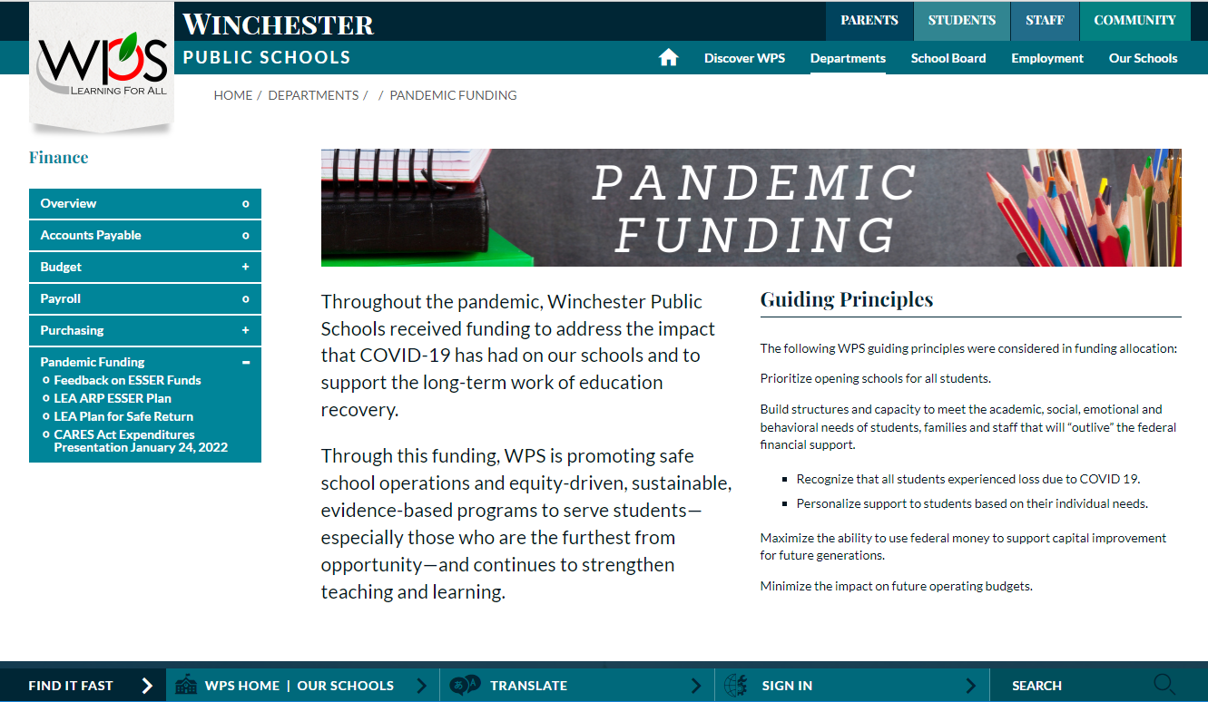
On the Finance Department section of the WPS website, we created a tab dedicated to Pandemic Funding. The following plans are required to be posted.
LEA ARP ESSER Plan
LEA Plan for Safe Return
School Division/LEA
ESSER Spending Plan

